Slide 1
Neural Networks
Jan Kościałkowski
18 May 2020

Slide 2
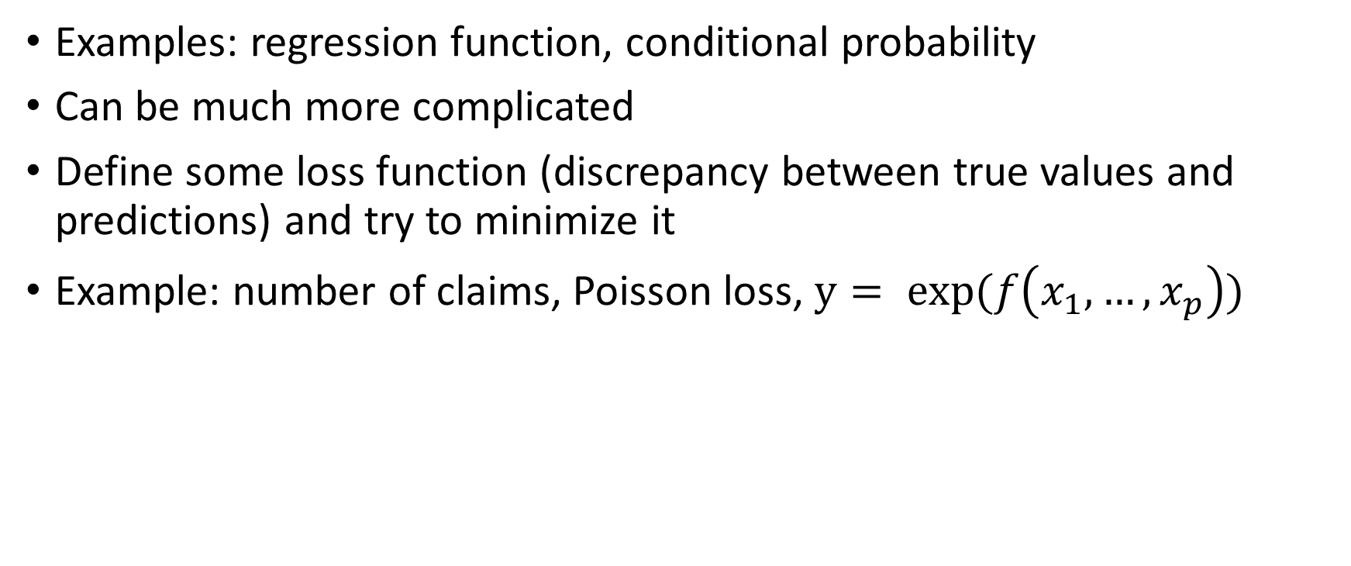
Idea: approximate some function
Examples: regression function, conditional probability
Can be much more complicated
Define some loss function (discrepancy between true values and predictions) and try to minimize it
Example: number of claims, Poisson loss, $y= exp⁡(f\left(x_{1},…,x_{p}\right))$

Slide 3
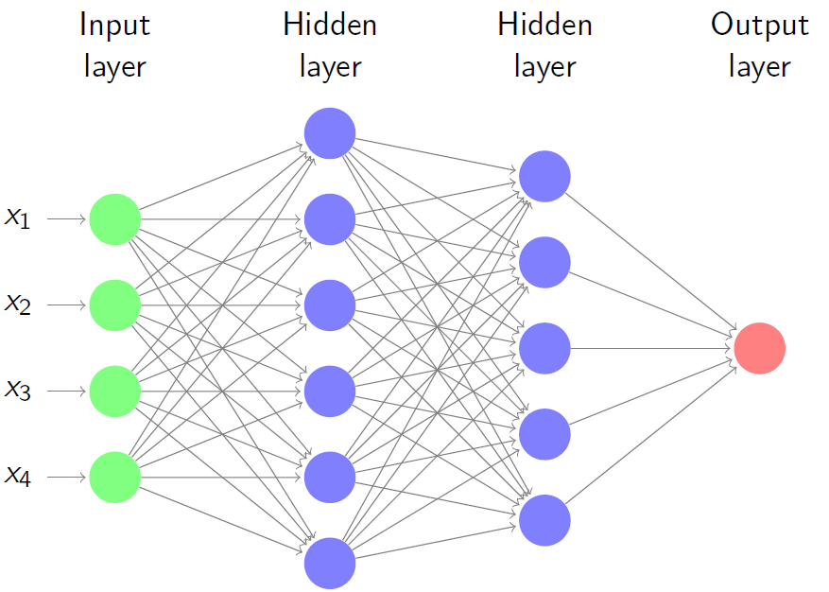
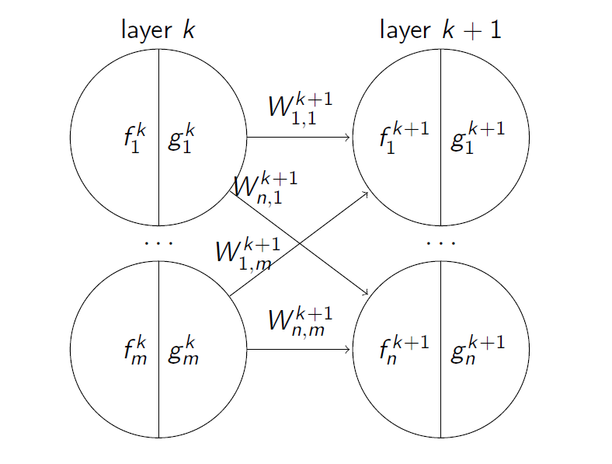
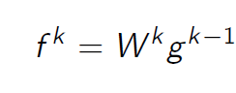
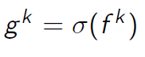
Multi-Layer Perceptron (MLP)
Nodes – apply activation function
Edges – matrix multiplication
Universal Approximation Theorem (Cybenko 1989): Approximates any continuous function on a compact subset of ℝ^{d} arbitrarily well

Slide 4
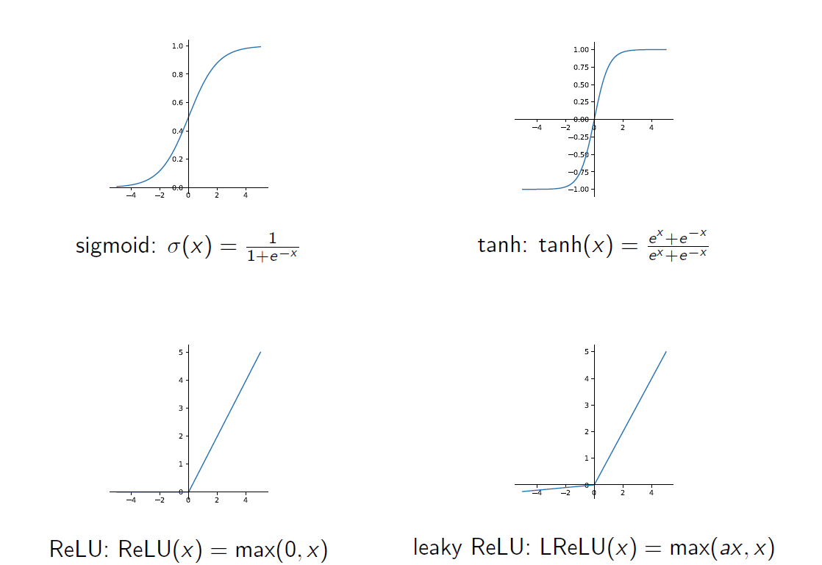
Activation Functions
Issue: saturation
Issue: dead ReLU

Slide 5
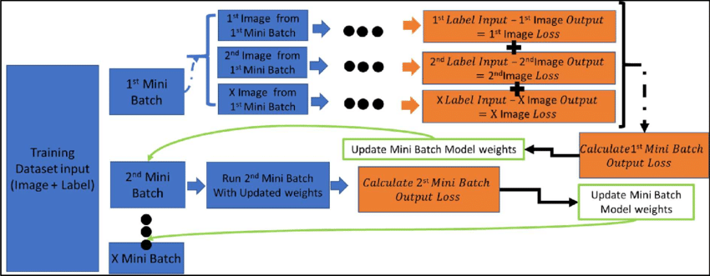
Mini-batch Learning
https://www.researchgate.net/figure/Example-of-mini-batch-learning-on-CNN_fig41_339054847

Slide 6
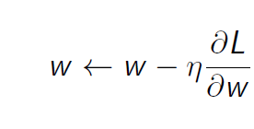
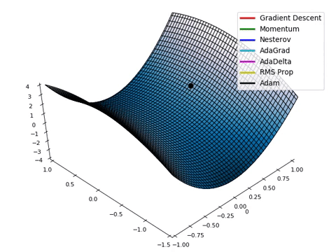
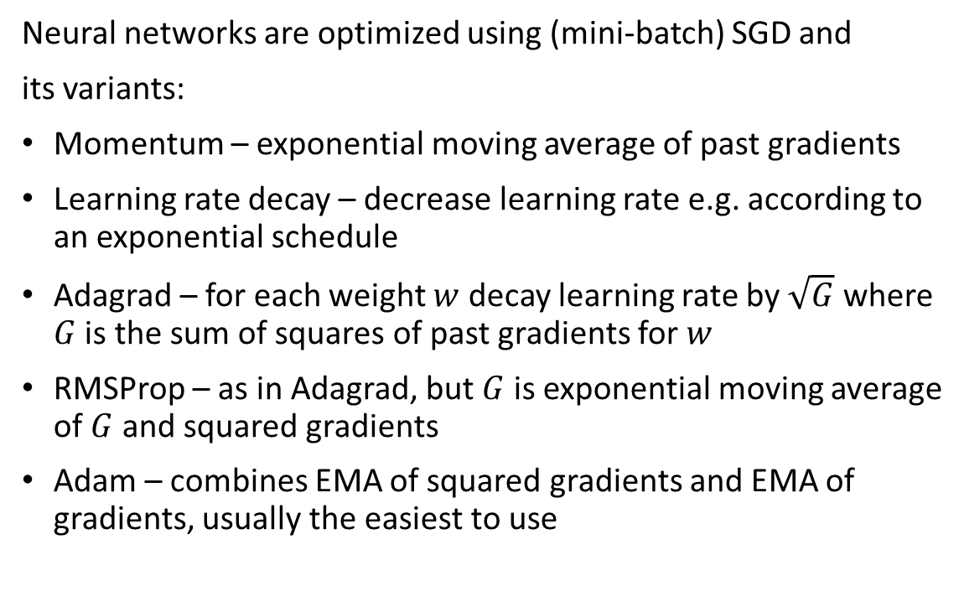
Optimization
Neural networks are optimized using (mini-batch) SGD and
its variants:
Momentum – exponential moving average of past gradients
Learning rate decay – decrease learning rate e.g. according to an exponential schedule
Adagrad – for each weight $w$ decay learning rate by $\sqrt{G}$ where $G$ is the sum of squares of past gradients for $w$
RMSProp – as in Adagrad, but $G$ is exponential moving average of $G$ and squared gradients
Adam – combines EMA of squared gradients and EMA of gradients, usually the easiest to use
https://rnrahman.com/blog/visualising-stochastic-optimisers/

Slide 7
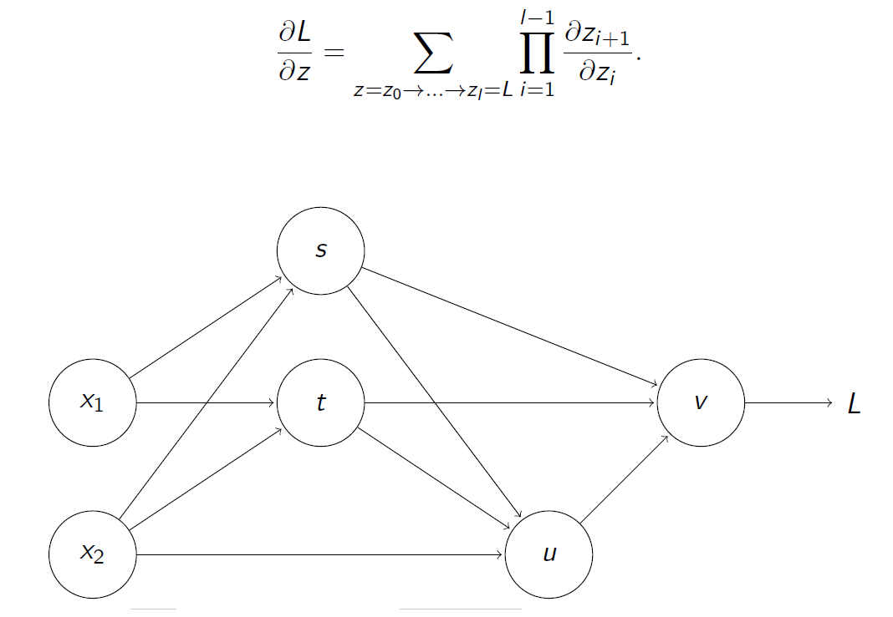
Backpropagation
We need derivatives of loss function w.r.t. weights for SGD
Use multi-dimensional chain rule to decompose derivative computations into products of step-by-step derivatives
In general, works for DAGs of differentiable operations (including MLP)
Idea – for each mini-batch do the following:
Forward pass: run the input data through the network and compute all intermediate values
Compute the value of the loss function
Compute the single-step derivatives going backwards from the loss function
Multiply them to get the desired derivatives

Slide 8
Regularization
NNs are usually too complex for tabular data, heavy regularization needed:
L1, L2
Data augmentation – perturb the real data (add noise, offset, distort etc.)
Dropout – randomly omit network edges during training
Batch, layer normalization – normalize across different dimensions of the batch to try to make the distributions more normal
Early stopping – monitor validation set metrics and stop training when they stop improving

Slide 9
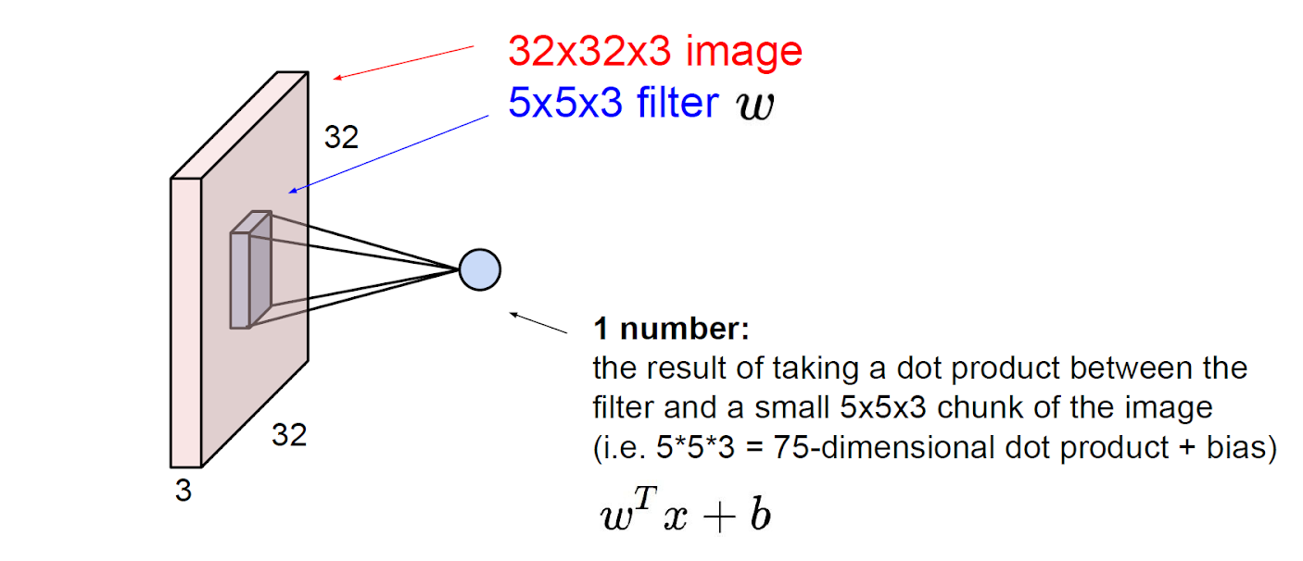
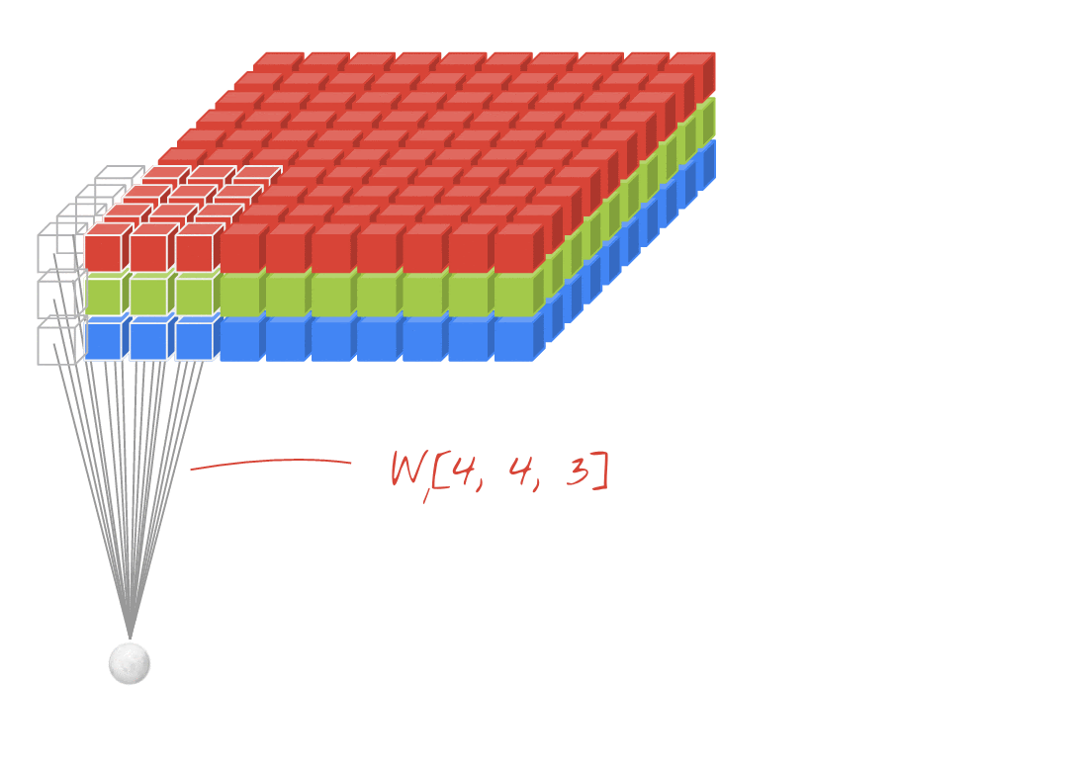
Convolutional Networks
https://cs231n.github.io/convolutional-networks/
https://codelabs.developers.google.com/codelabs/cloud-tensorflow-mnist/#10

Slide 10
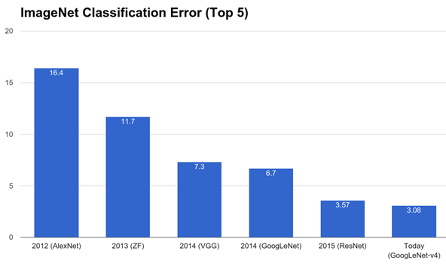
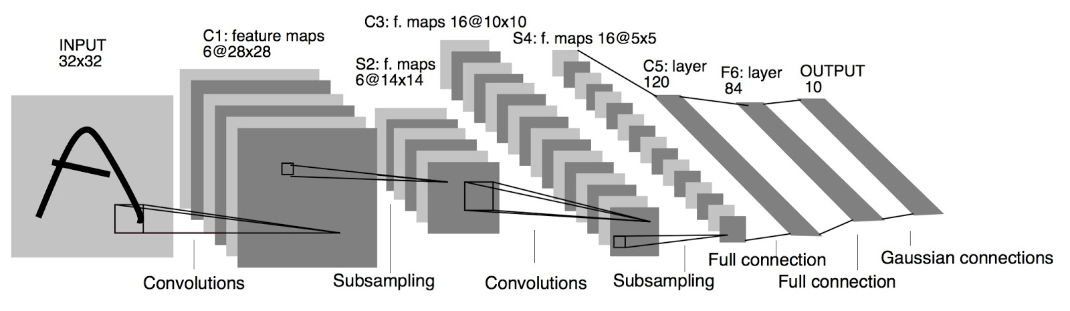
Convolutional Networks: History
Around since 1980s
LeNet-5 (LeCun et al. 1998) – handwirtten digit recognition
Due to GPU utilization, massive advances since 2012 + switch from SVMs to NNs

Slide 11
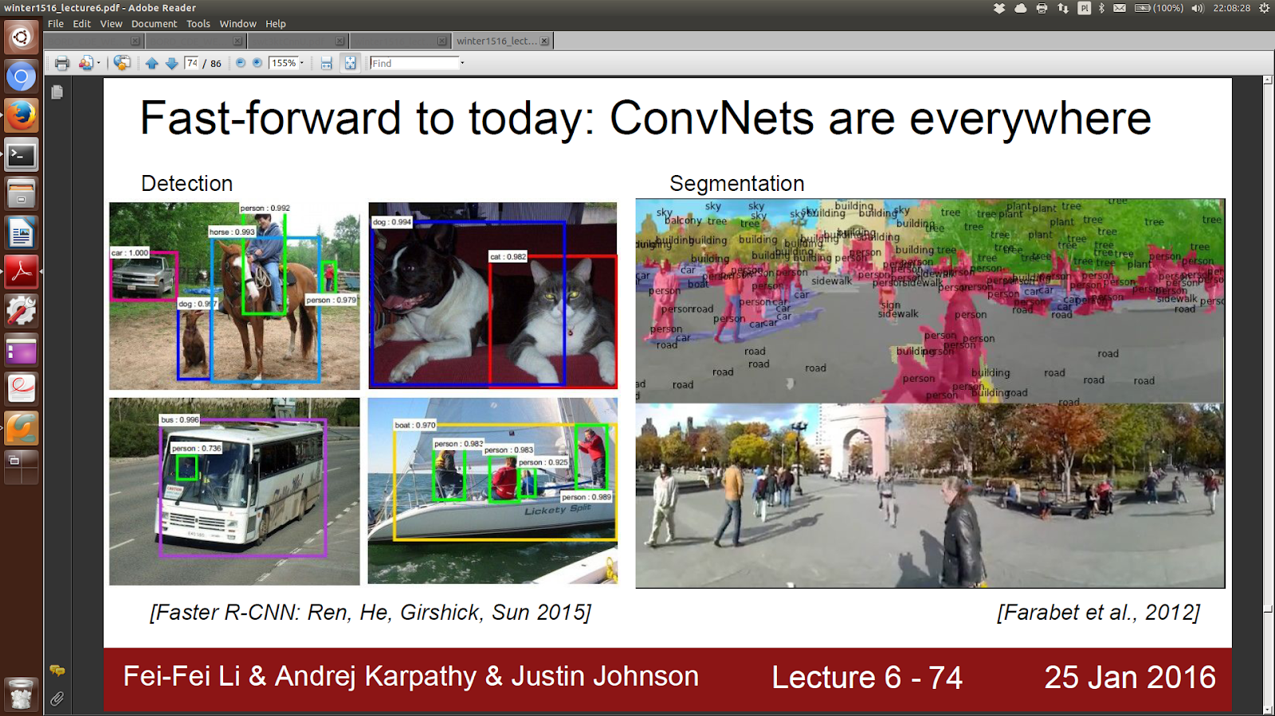
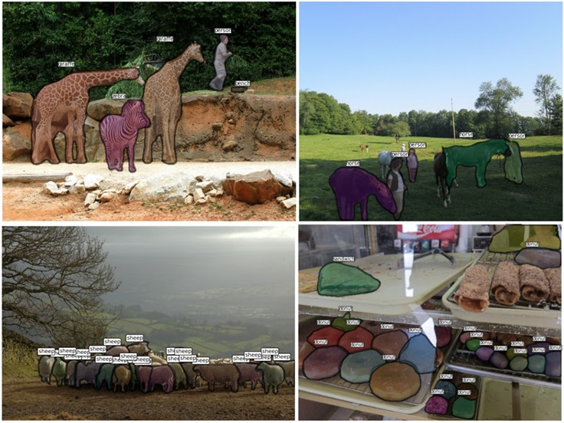
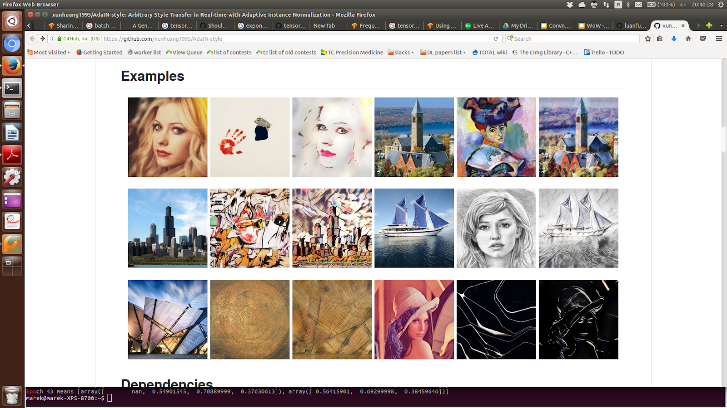
Convolutional Networks: Use Cases
Detection
Segmentation
Style Transfer
https://pjreddie.com/darknet/yolo/
https://github.com/xunhuang1995/AdaIN-style

Slide 12
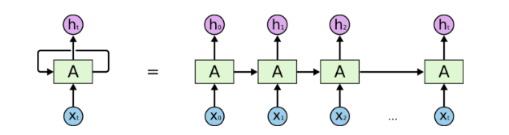
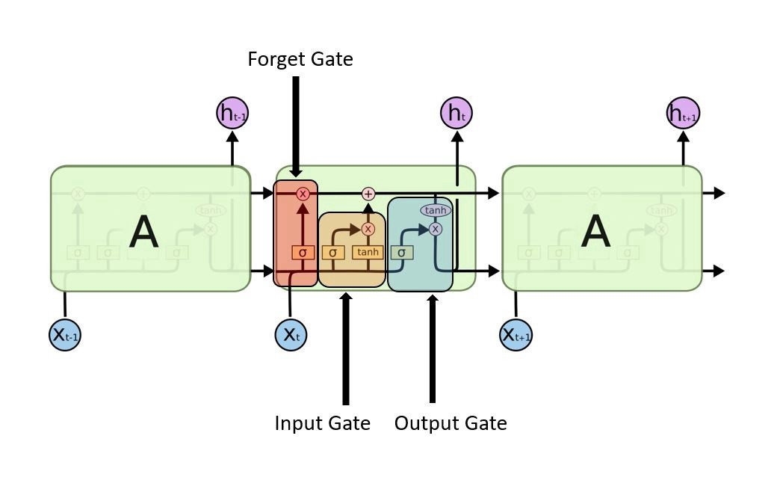
Recurrent Networks
RNN
Used for modeling sequential data: text, voice, time series etc.
Operations exactly the same as for MLP, but uses the concept of weight sharing and backpropagation through time.
LSTM
https://towardsdatascience.com/understanding-rnn-and-lstm-f7cdf6dfc14e

Slide 13
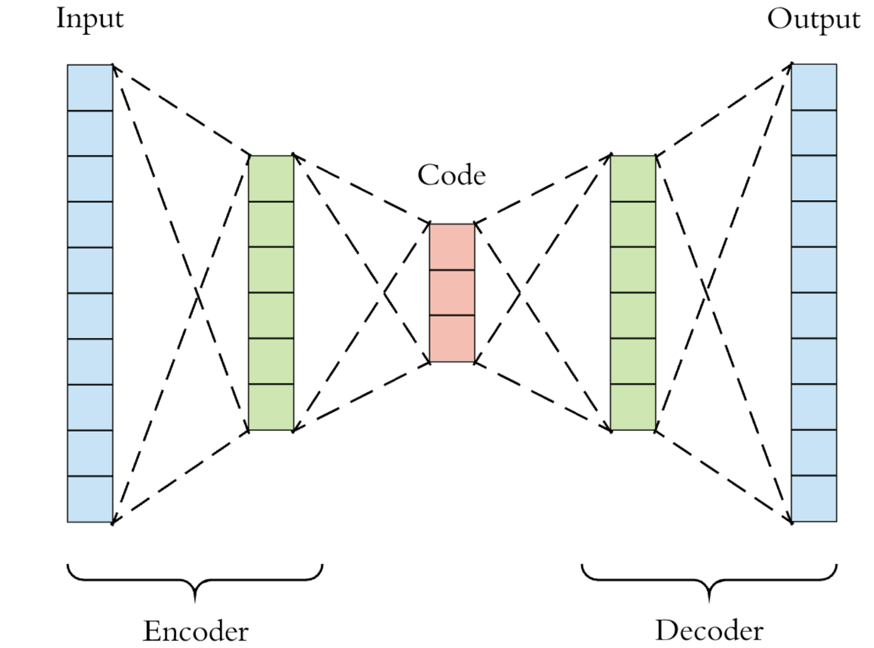
Representation Learning
NNs very good at learning well-performing low-dimensional representations of complex objects (words, images etc.)
Usually works by trying to reproduce the initial object or the context, the representations are taken to be outputs from some intermediate layer
Example: autoencoders
https://towardsdatascience.com/generating-images-with-autoencoders-77fd3a8dd368

Slide 14
Other Important Classes
Generative Adversarial Networks (generating fake photos/videos)
Reinforcement Learning (learning by interaction with environment)
Transformers (NLP, new models have billions of learnable weights)
TBC…

Slide 15
Toolkit
Python is the language of choice for Deep Learning research and prototyping, but compiled languages are often used for production uses (e.g. C++, Go)
Pillow
NLTK
PyTorch
Pytorch Lightning/Ignite
Tensorflow (has R API)
Keras
ONNX

Slide 16
Resources
http://www.deeplearningbook.org/
https://pytorch.org/tutorials/beginner/deep_learning_60min_blitz.html
https://www.tensorflow.org/tutorials
StackOverflow
Elements of Statistical Learning, Chapter 11

